Slide 1
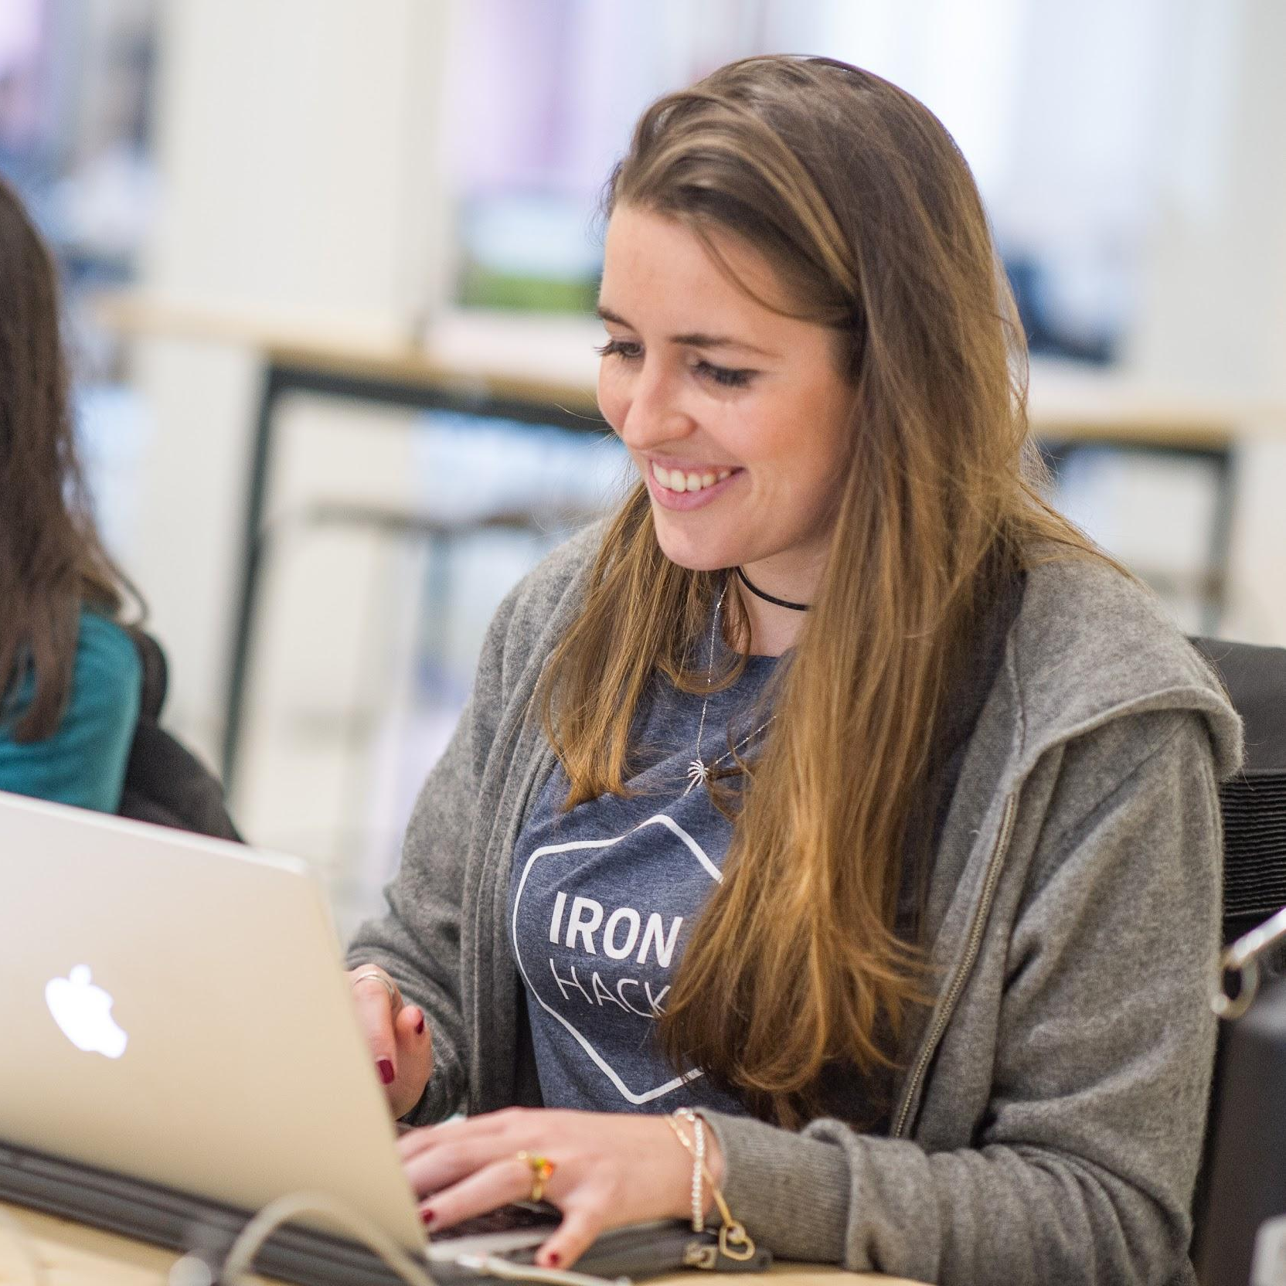
Introduction to NLP
DATA ANALYTICS | IRONHACK

Slide 2
WHAT IS?
Making computers understand text
Switching text to numbers

Slide 3
APPLICATIONS:
Email spam filters
Predictive text
Language translations
Spell checking
Sentiment analysis
Social media monitoring
….

Slide 4
BASIC APPROACH: BAG OF WORDS
Cast sentences into numbers ( one sentence, one observation )
In order to do that, we can consider a sentence as one categorical column and use: ONE-HOT-ENCODING ( dummify ) for every possible word in the sentence.
Problems:
the possible number of words ( tokens ) in a sentence is huge! We will have thousands of new columns in the dataframe.
duplicated words

Slide 5
TOKENIZATION
It gets every word of the sentence into a new element of a list, nor only the unique ones, so the list will have duplicates.
['It', 'gets', 'every', 'word', 'of', 'the', 'sentence', 'into', 'a', 'new', 'element', 'of', 'a', 'list', ',', 'not', 'only', 'the', 'unique', 'ones', ',', 'so', 'the', 'list', 'will', 'have', 'duplicates', '.']

Slide 6
DATA CLEANING:
To use this approach, we need to:
Drop special characters: punctuation, exclamations,...
Drop too many spaces
Drop numbers
Lowercase all the words
Drop stop words
Lemmatization / stemmer

Slide 7
STOPWORDS:
We want to keep only “meaningful words”:
Drop ( articles, prepositions,...)
['i', 'me', 'my', 'myself', 'we', 'our', 'ours', 'ourselves', 'you', "you're", "you've", "you'll", "you'd", 'your', 'yours', 'yourself', 'yourselves', 'he', 'him', 'his', 'himself', 'she', "she's", 'her', 'hers', 'herself', 'it', "it's", 'its', 'itself', 'they', 'them', 'their', 'theirs', 'themselves', 'what', 'which', 'who', 'whom', 'this', 'that', "that'll", 'these', 'those', 'am', 'is', 'are', 'was', 'were', 'be', 'been', 'being', 'have', 'has', 'had', 'having', 'do', 'does', 'did', 'doing', 'a', 'an', 'the', 'and', 'but', 'if', 'or', 'because', 'as', 'until', 'while', 'of', 'at', 'by', 'for', 'with', 'about', 'against', 'between', 'into', 'through', 'during', 'before', 'after', 'above', 'below', 'to', 'from', 'up', 'down', 'in', 'out', 'on', ...]

Slide 8
STEMMING:
We don’t want derivative words, we want the stem of the word:
Picture, pictures, ….
Leader, leaders,...

Slide 9
WORD FREQUENCY:
Initially we wanted to dummify the stems, but...only the presence of each stem or the frequency of each stem in the sentence?
If an stem appears five times, then five.

Slide 10
BAG OF WORDS PROBLEMS:
We only keep track of the most frequent words, not the context.
The relationship and position of the words of the words don’t make a difference, we can’t keep track of irony.

Slide 11
BAG OF WORDS IMPROVEMENT:
We use tuples of words centered around a given word: n-grams
‘I would like to be a data scientist’
2-grams: (I, would), (would, like), (like, to), (to, be), (be, a)....
3-grams: (I, would, like), (would, like, to),....
Problems: we have much more combinations = N^2 (N = number of possible words)

Slide 12
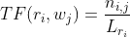
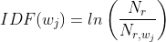

BEYOND BAG OF WORDS: TF-IDF TRANSFORMATION
If the word is an article, then it will appear a lot of times in the sentence. However, this doesn’t mean that this word is relevant.
To compensate for this, an improved metrics is called the TF-IDF
TF-IDF is computed for each word and is made of the multiplication of two terms:
TF = Term Frequency = number of times that a given word appears in a sentence -> normalize by length of the sentence
IDF = Inverse Document Frequency = number of sentences / number of sentences that contain the given word -> normalize by (document frequency)^-1

Slide 13
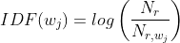
TF-IDF: AN EXAMPLE
One sentence contains the word “dog” 3 times and it has 10 words.
TF(sentence, “dog”) = 3/10
The documents contains 10M of sentences and only 1K contain the word “dog”
IDF(“dog”) = log(10000000/1000) = log(10000) = 4
TF-IDF(“dog”) = TF * IDF = (3/10)*4 = 12/10 = 1.2
This approach can be applied to 1-grams, 2-grams, 3-grams,...etc.

Slide 14
PYTHON LIBRARIES FOR NLP:
NLTK ( really heavy, several GB, not easy installations ) Official documentation
Spacy ( lighter ) Official documentation
Considerations:
Usually those libraries uses different databases “corpus” for every language and topic ( a legal text is not the same as an sports one )
You can create your own “corpus” specific for your dataset.

Slide 15


